Slide 1
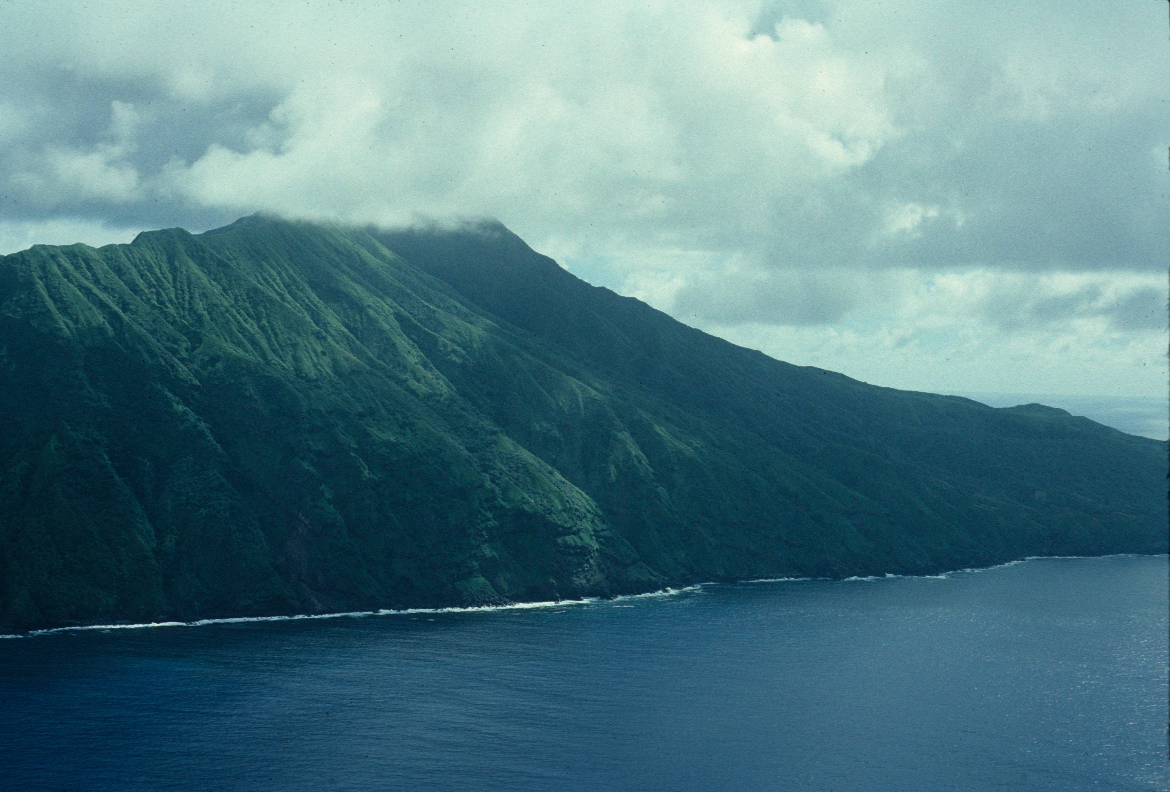
Density-dependent and Density-independent Events
The role of catastrophic events, introduced predators and competitors in endangerment.

Slide 2
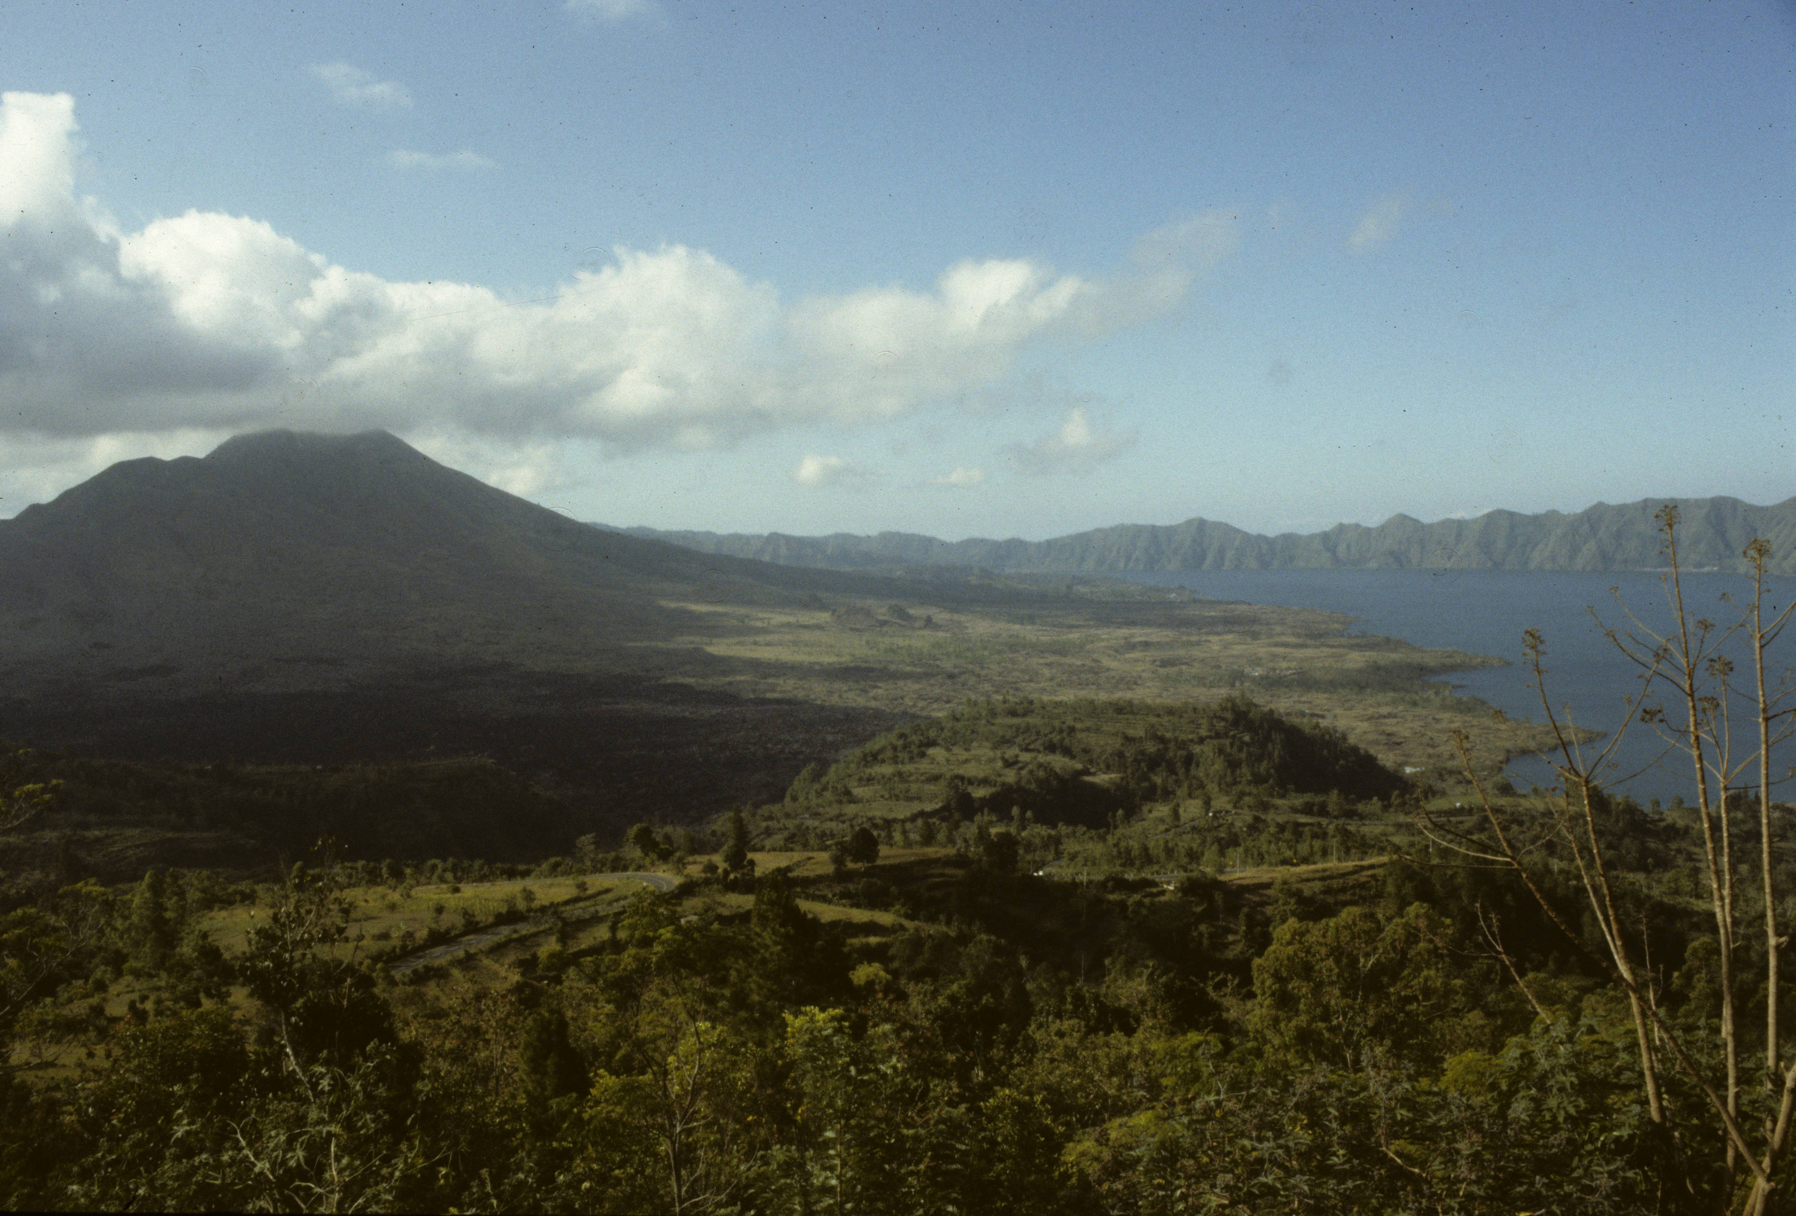
Excerpt from Islands
Mount Agung forms the substance and soul of the island of Bali. It broods over the island at dawn, but then evaporates into tropical clouds until it again reveals itself in the sparkling stillness of another morning. It is Saturn, the bringer of old age, and Neptune, the mystic. It is placid, and verdant, and in an instant it is Mars, an inferno spewing rocks and toxic gas; a twin to its former neighbor Krakatoa. Agung is the cataclysmic destructor, and yet its black volcanic earth gives life to a bewildering profusion of beings.

Slide 3
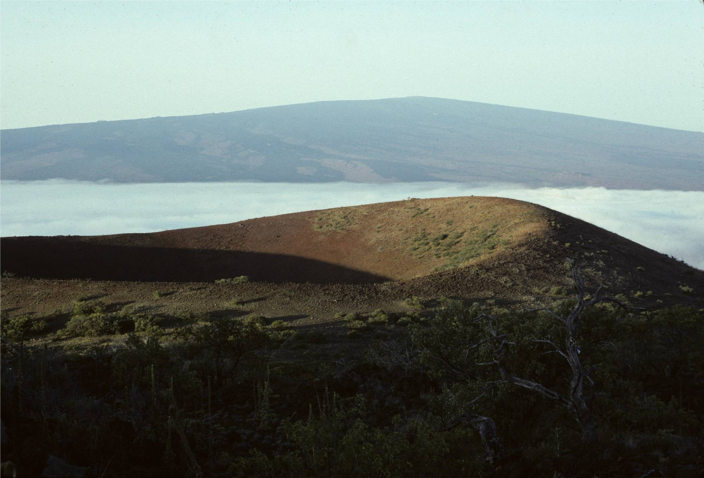
Objectives
Investigate the role of catastrophic events in population collapses and in pushing endangered populations into extinction.
Consider the role of invasive species in bringing about population declines and extinction.

Slide 4
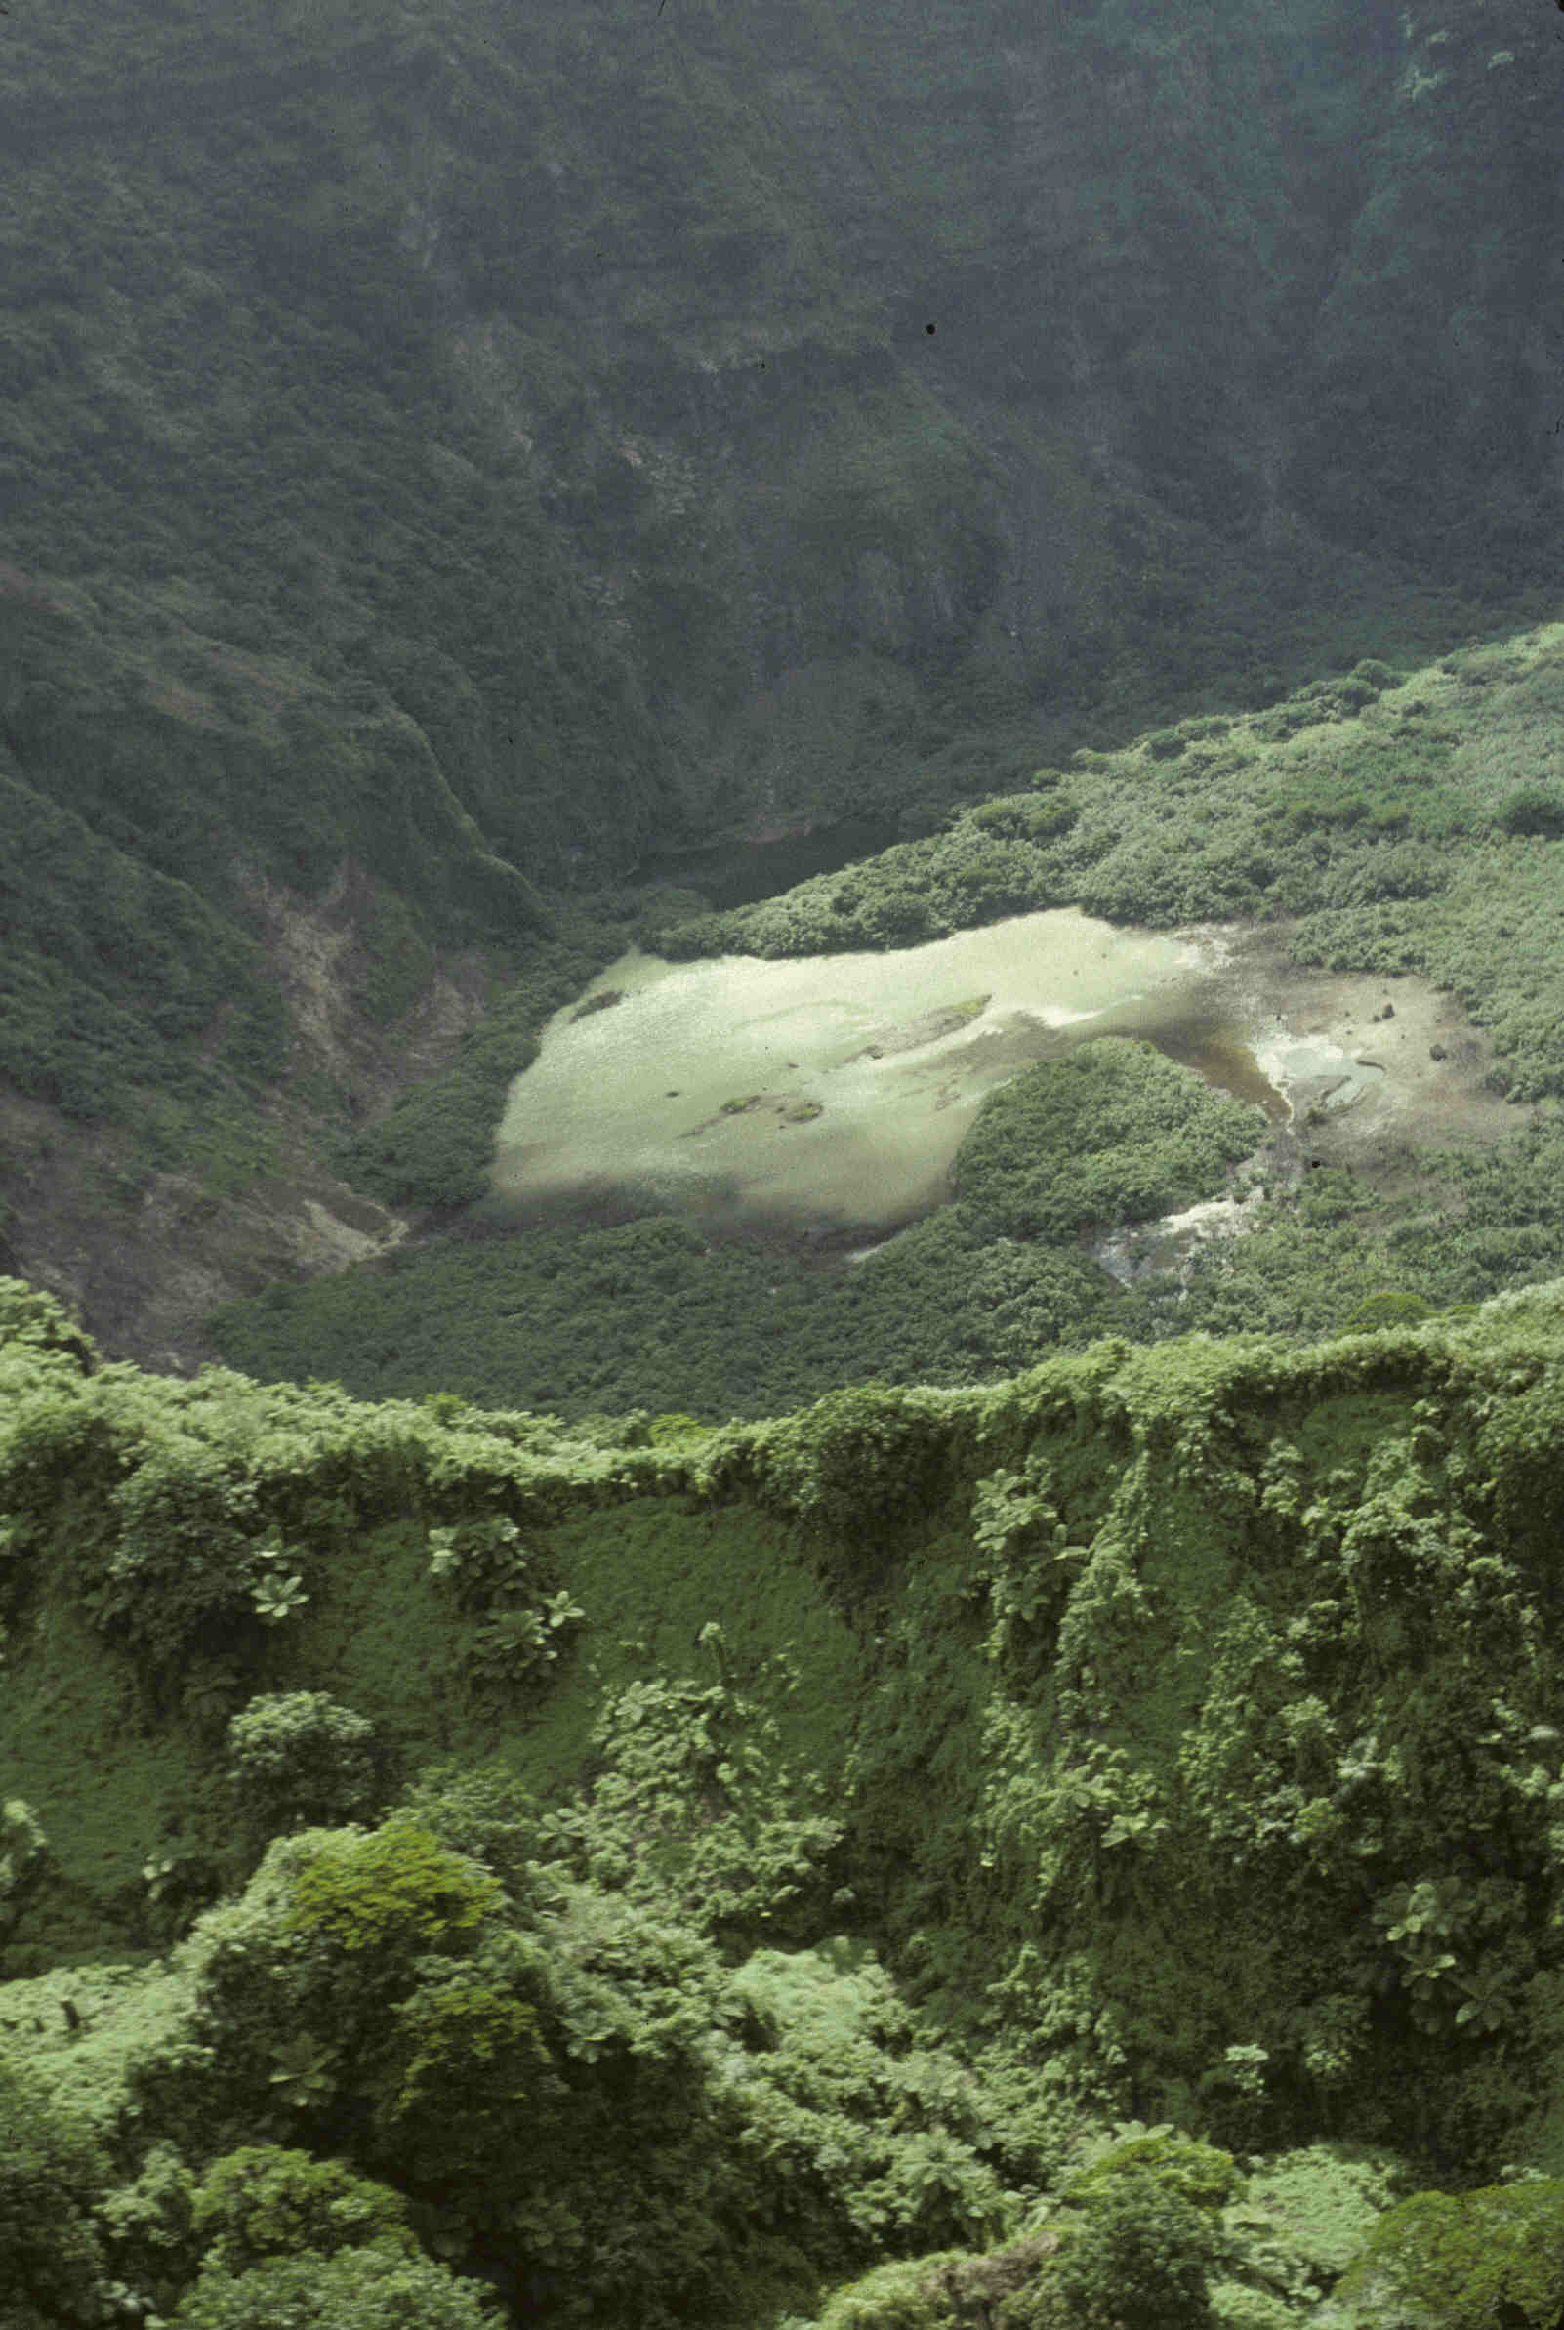
Catastrophic Events
The spores of Spaeropteris species of tree ferns are wind-dispersed, so they can colonize even remote tropical Pacific islands.
However, in isolation in the northern Mariana Islands, they have speciated into S. aramagensis, which occurs on volcanic soils. It is at the rim of the volcano at right (palm-like crowns) on the island of Anatahan.
Its populations on these small, actively volcanic islands are largely undisturbed by human activity. Anatahan has been uninhabited since 1990 when earthquake swarms began to occur.
Hence, these populations appear to be secure even though small.
However, they are vulnerable to density-independent events- those with population effects unrelated to population density.

Slide 5
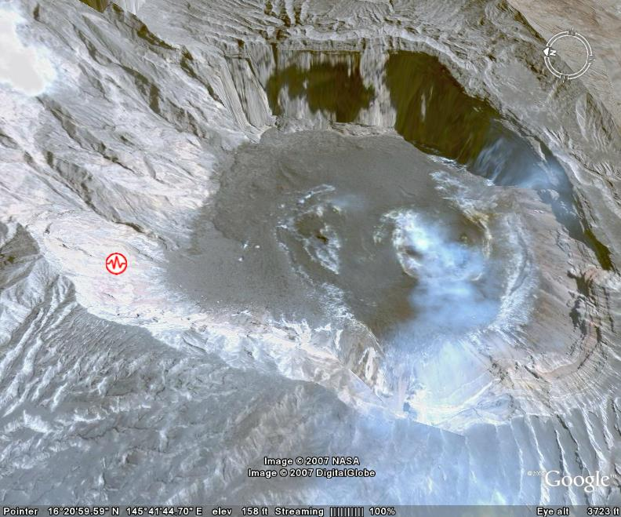
Catastrophic Events- continued
The previous image was taken in 1991; the image at right is of the same location after the 2003 eruption of the volcano. Although a geologically young volcano, it had never erupted historically– i.e. it was a low probability event.
The explosive eruption sterilized much of the island of life whether species were common or rare.
Hence, the population of S. aramagensis became locally extinct without regard for its population size.
In this instance, it seems likely that spores in the soil will still germinate and re-establish this population, but for k-selected species, such an event would likely result in permanent extinction.
Low probability or random events tend to become more important to the trajectories of small, isolated populations.
As we have seen, although not responsible for the rarity of the Heath Hen, they were largely responsible for its extinction.

Slide 6
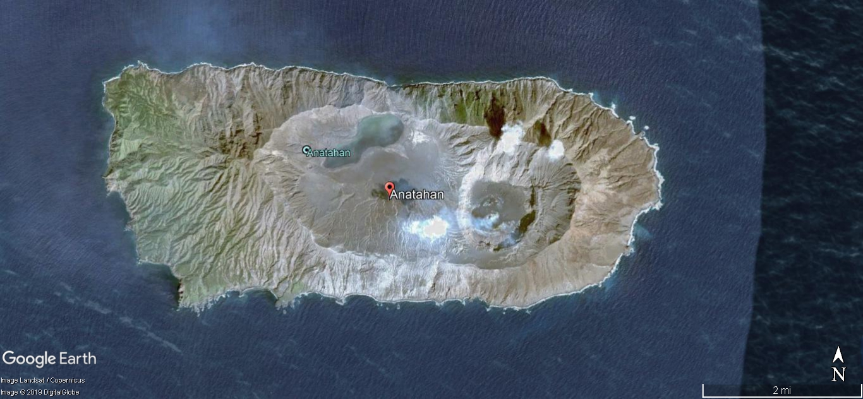
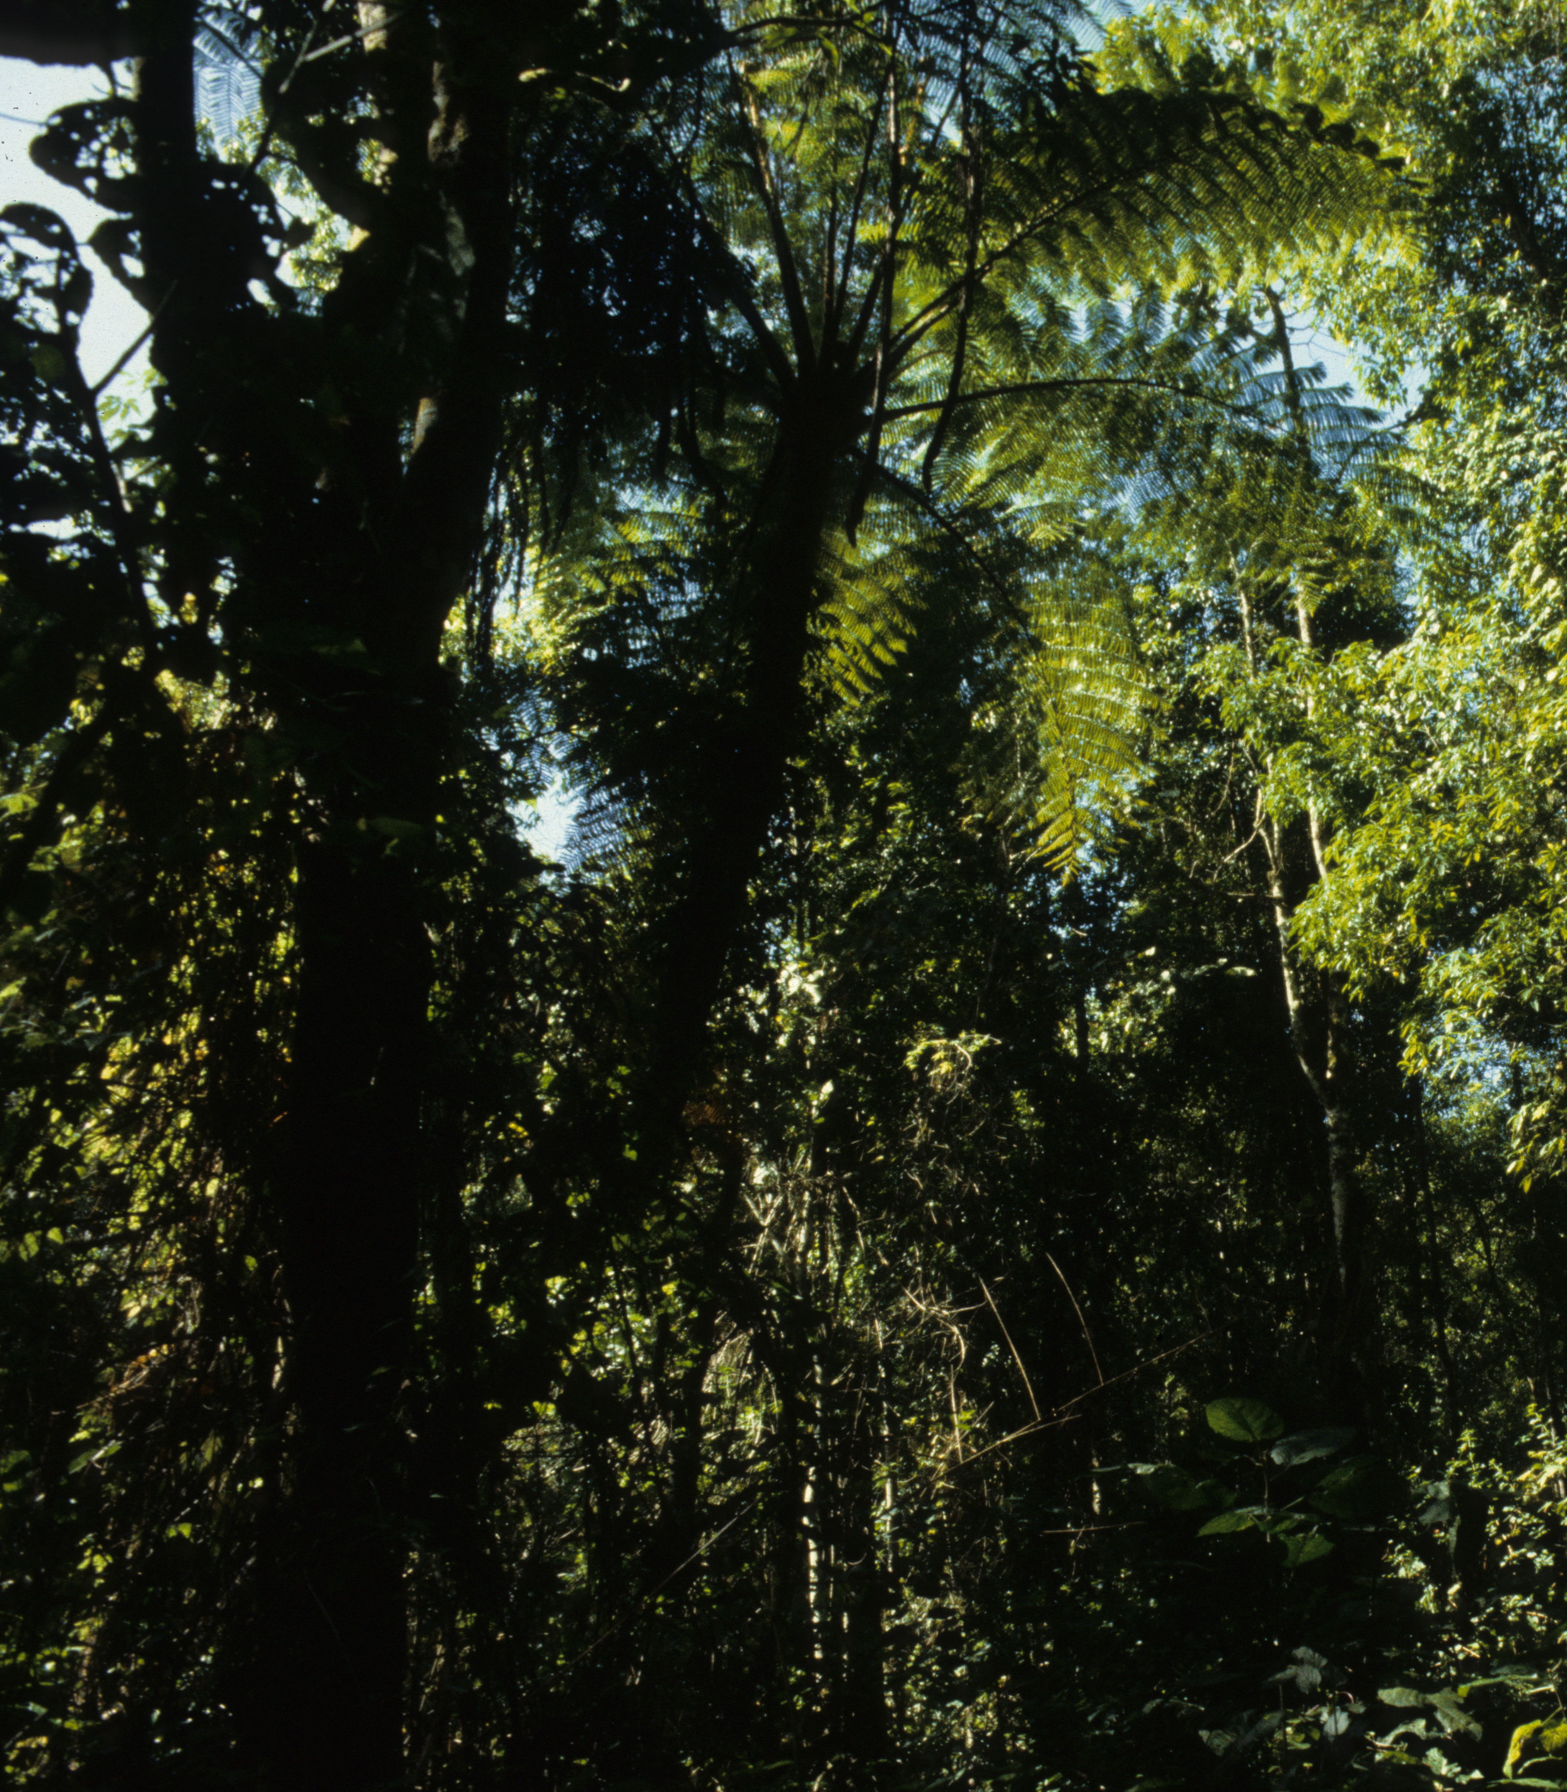
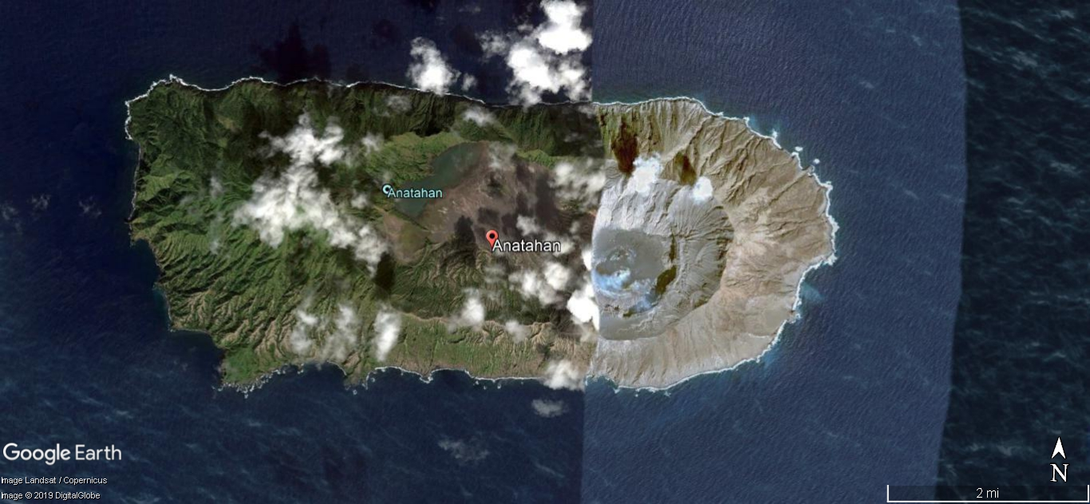
Recovery of Anatahan Vegetation
2005
Tree fern closeup
2014

Slide 7
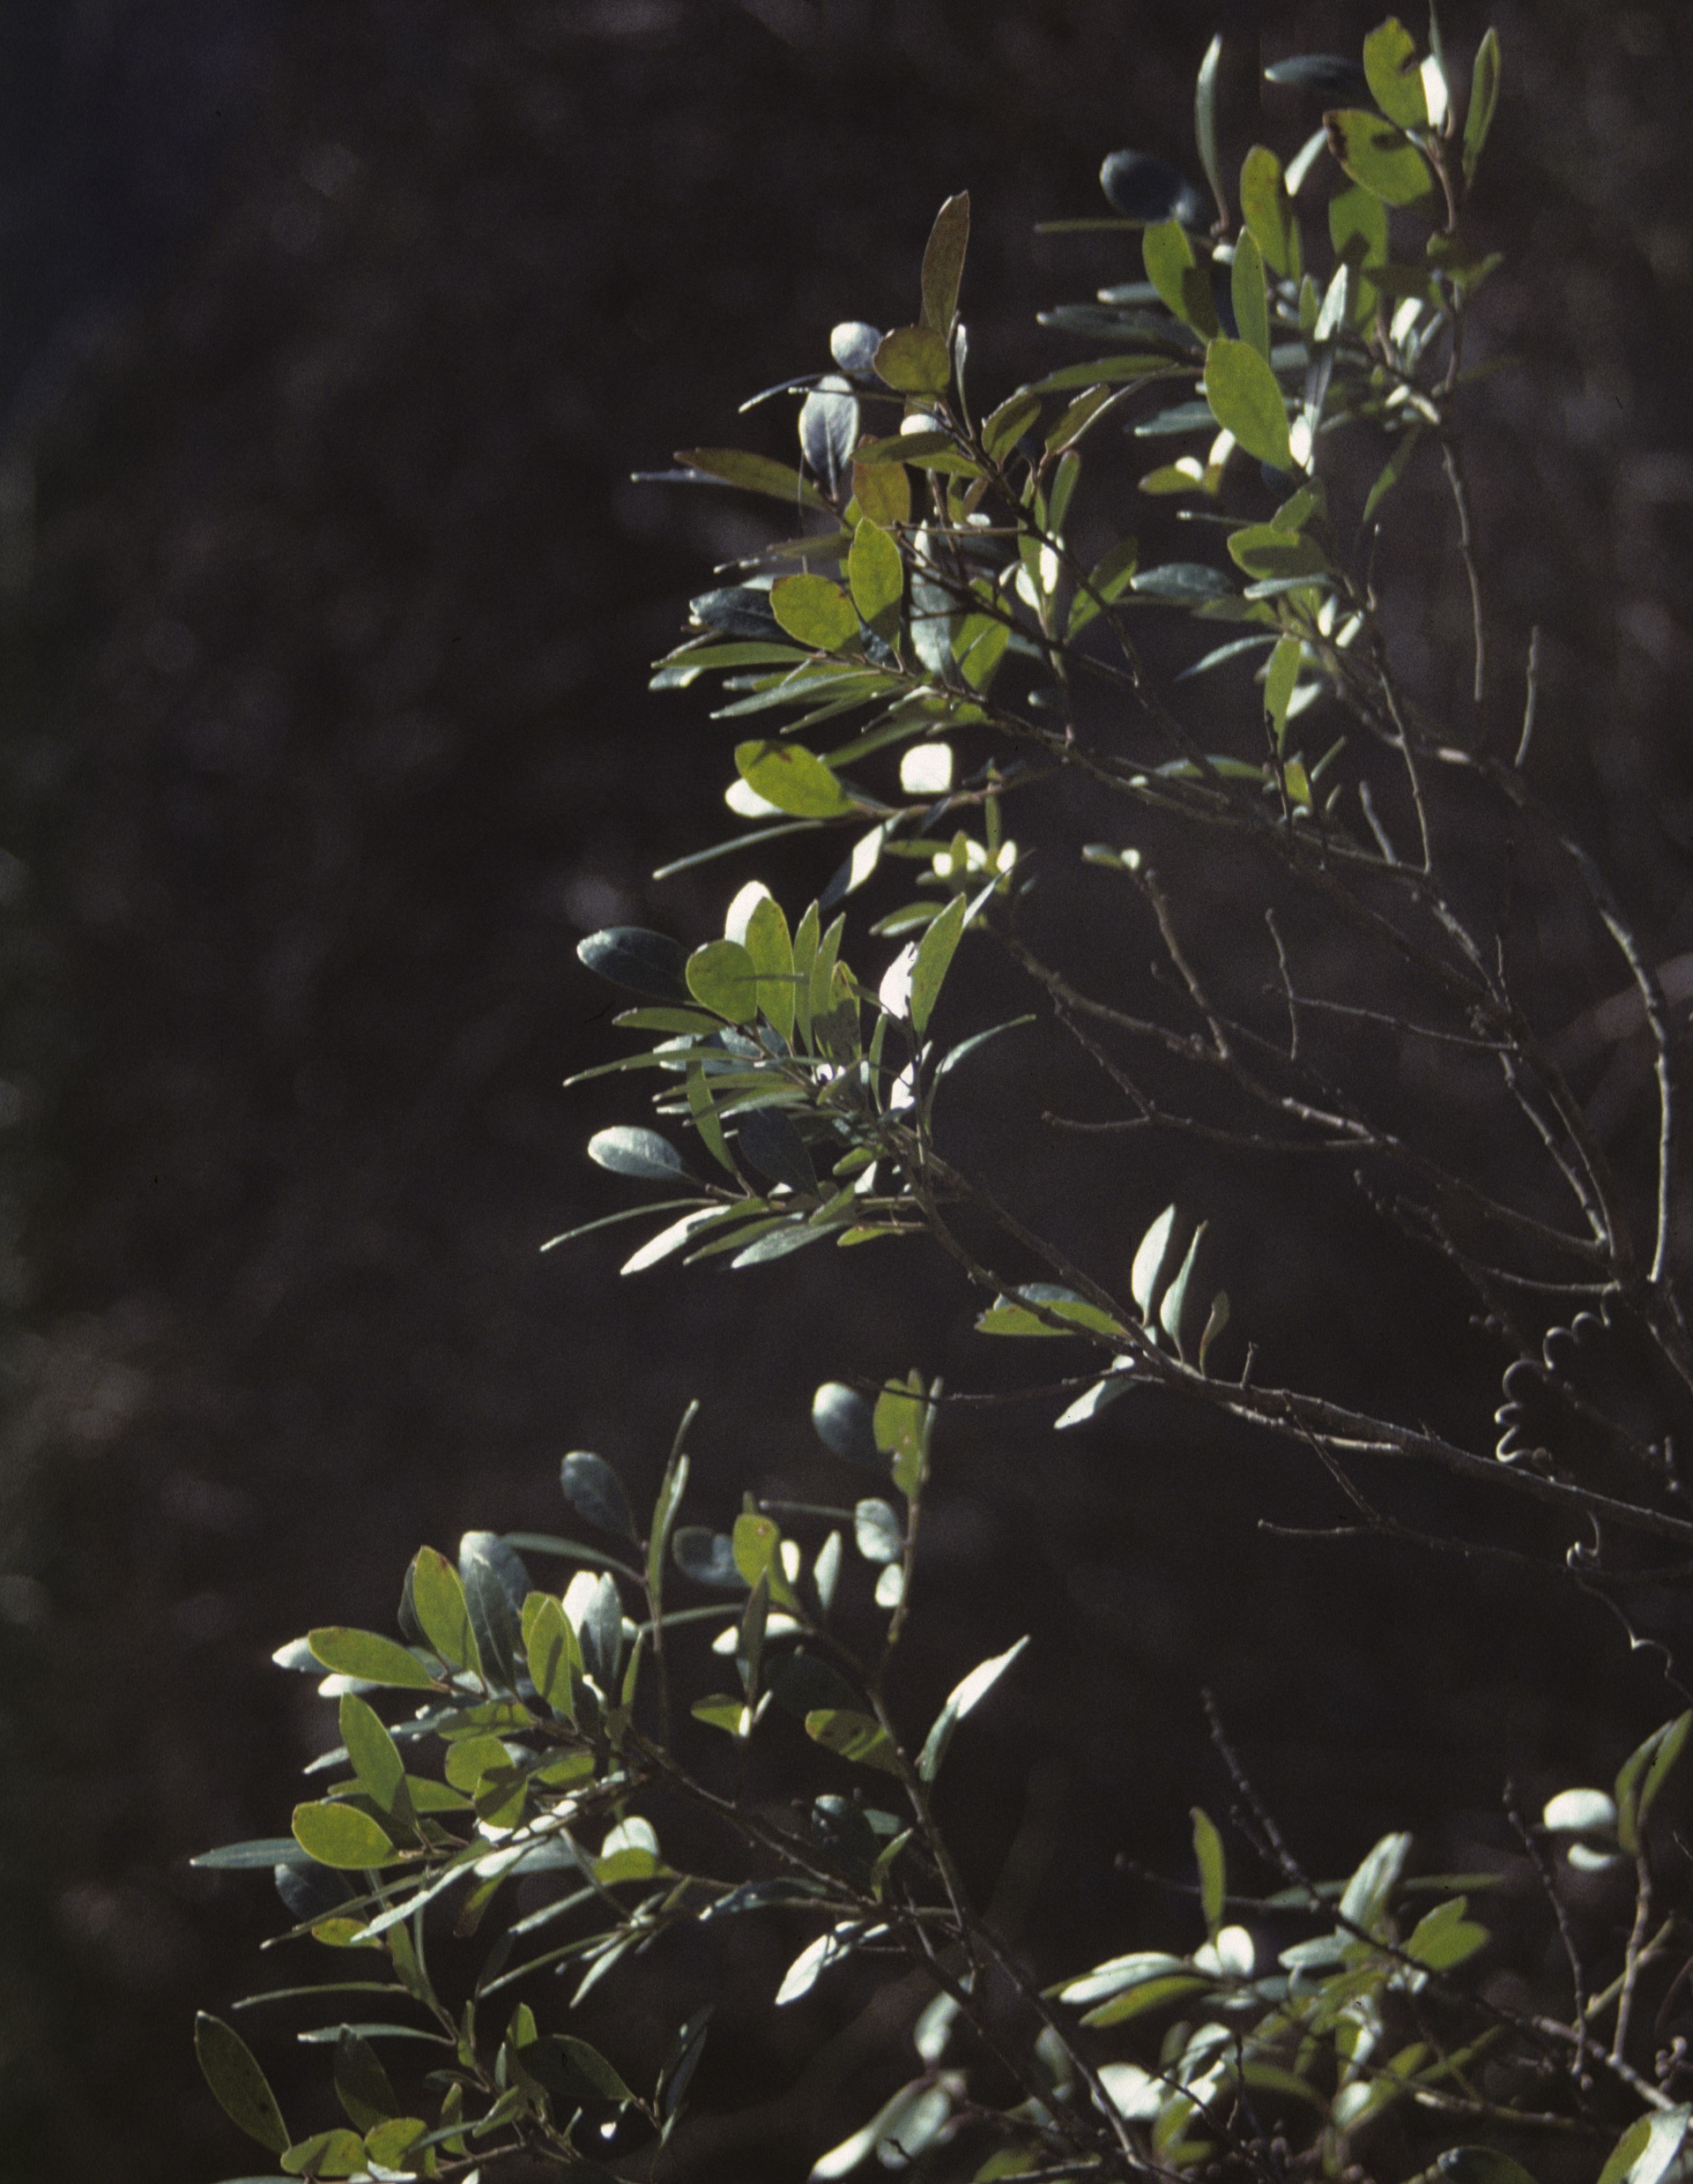
Density-independent
Effects
Other examples of density-independent phenomena include fire, storms, extreme cold and extreme heat.
Smooth Holly, Ilex glabra, is a common shrubby species of the southeastern coastal plain that grows rarely in coastal New England.
Its distribution is limited by winter low temperatures. Hence, its populations are limited by density-independent effects.
A number of plant species have their ranges limited by such factors, including some listed by states as being rare within their borders.
Even winter distributions of birds have been demonstrated to have their northern range limits determined in large part by winter temperatures.
Smooth Holly is rare in extreme southeastern Connecticut. It is more widespread in coastal Rhode Island.

Slide 8
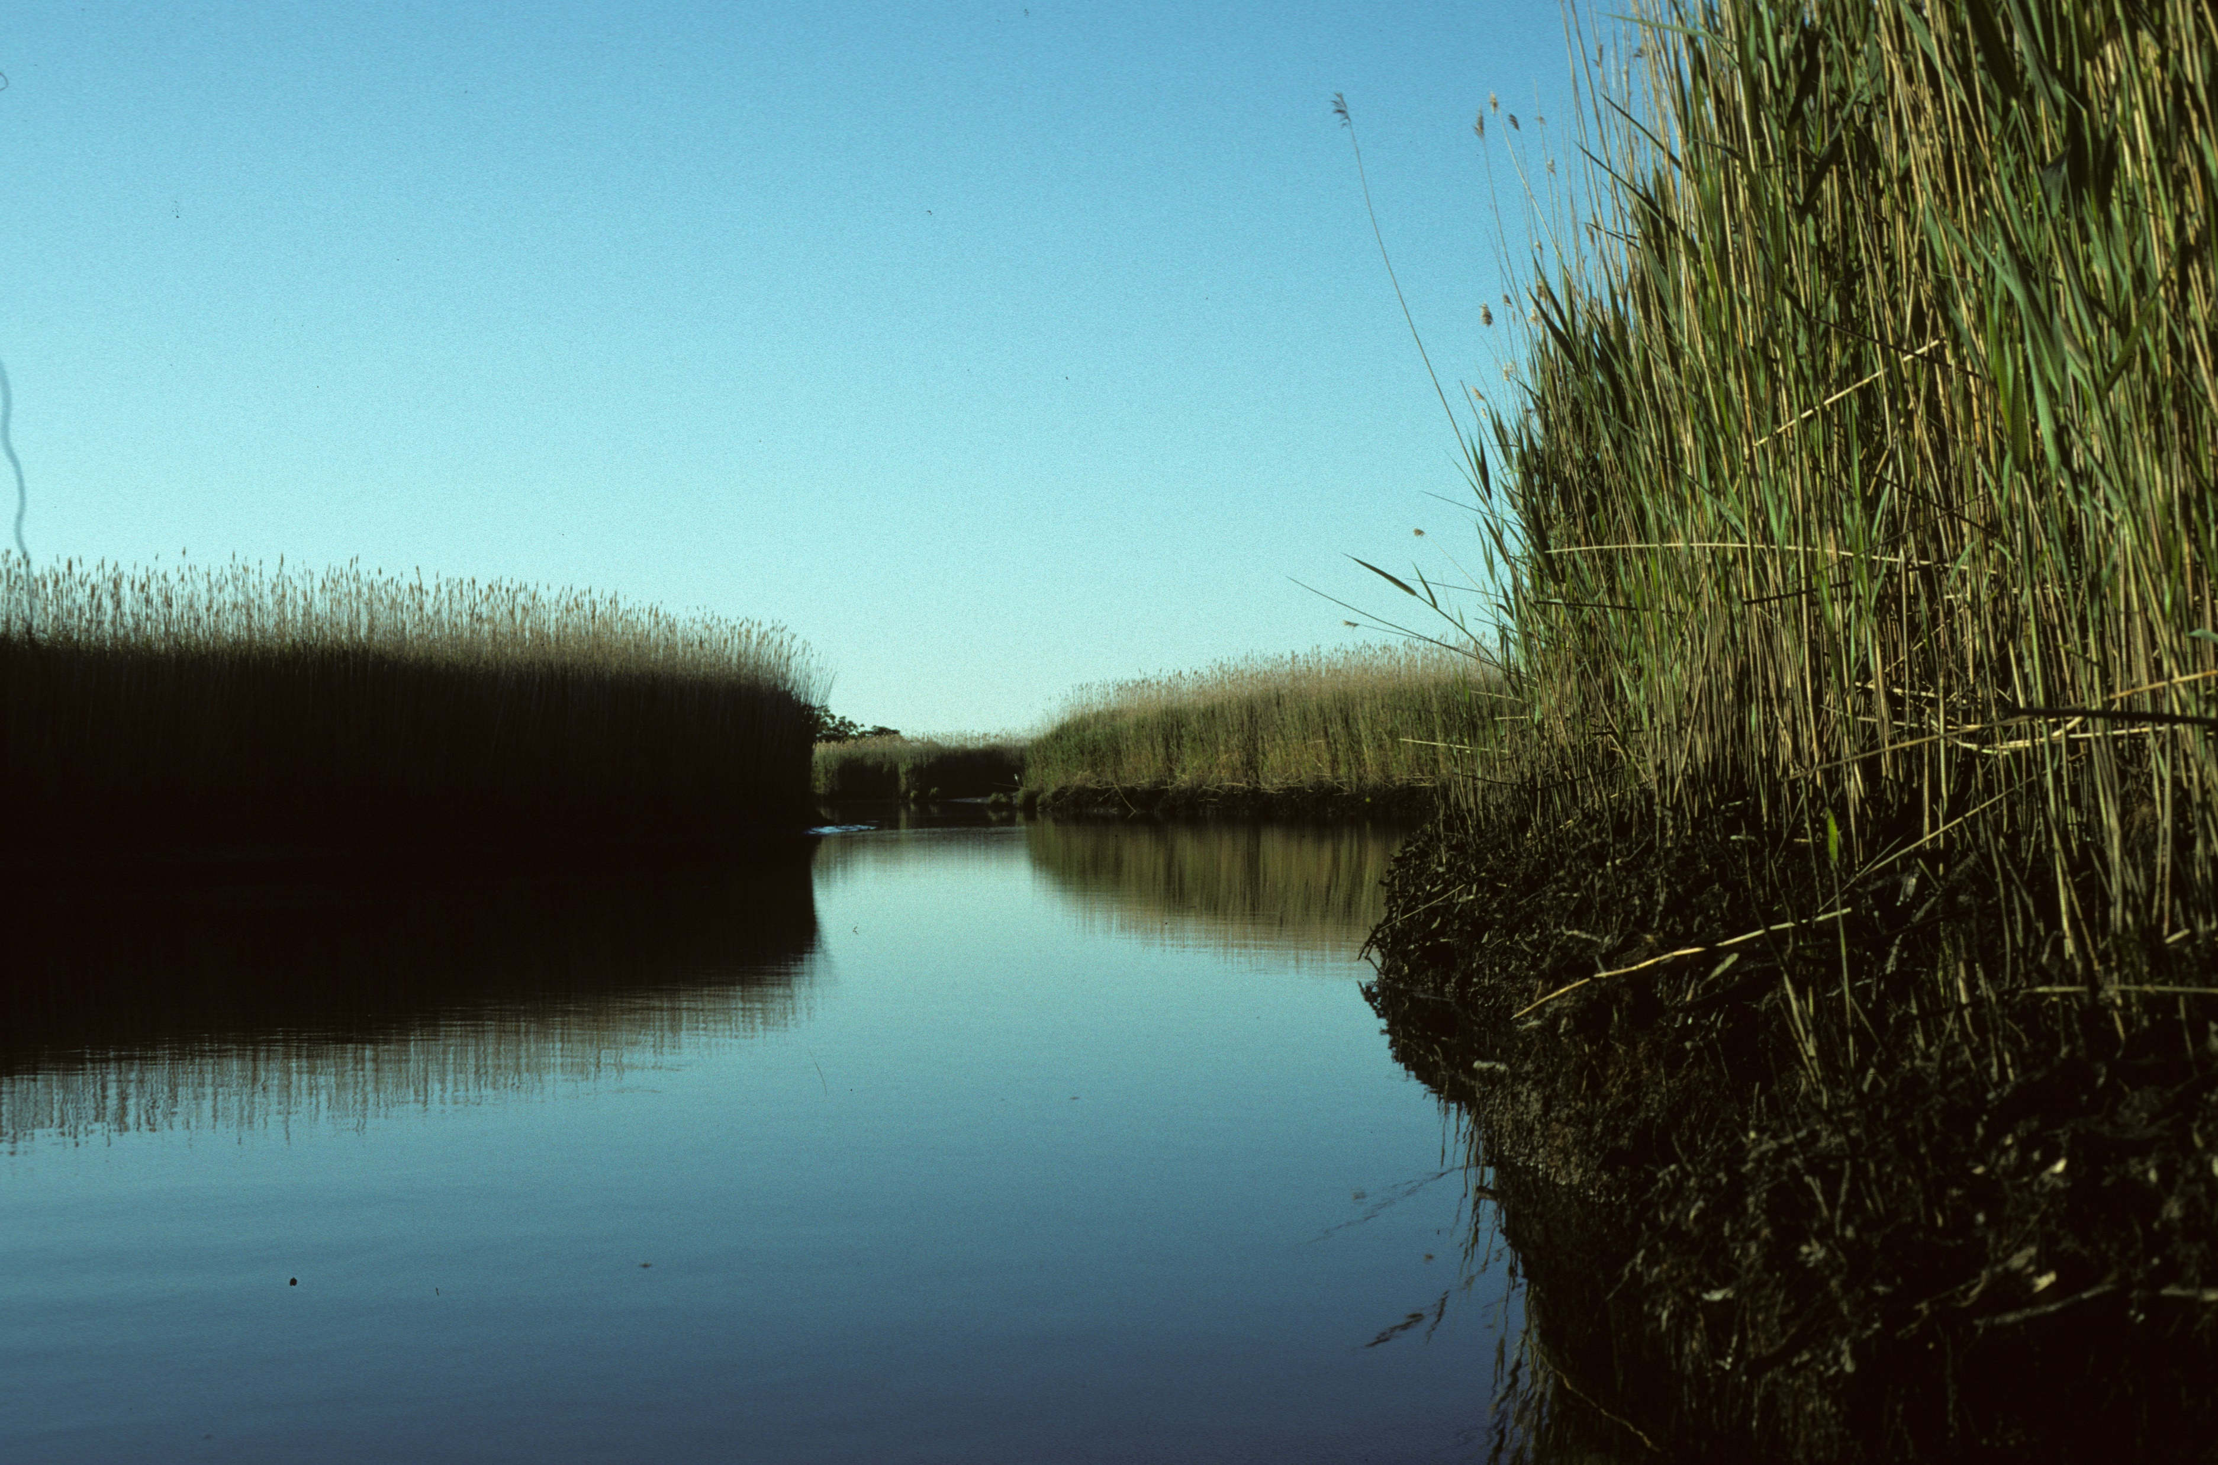
Invasive Species
When species are introduced into a new environment, they often leave their predators, competitors and diseases behind.
As a consequence, they may experience exponential growth and overwhelm native communities in effects that are density-dependent.
The Eurasian Common Reed, Phragmites australis, is an example that has displaced native marsh communities in North America.
Case study: the Connecticut River.
  Although a native subspecies had been found in sediment cores, the Eurasian form is a much more aggressive competitor and rapidly displaces native vegetation.
  High water salinity reduces its invasiveness and it tends not to replace salt marsh grasses (Spartina), but it overwhelms cattail (Typha) communities in more brackish upriver portions of the river.
Phragmites has largely taken over the brackish Upper Island marsh along the lower Connecticut River in Lyme, CT.

Slide 9
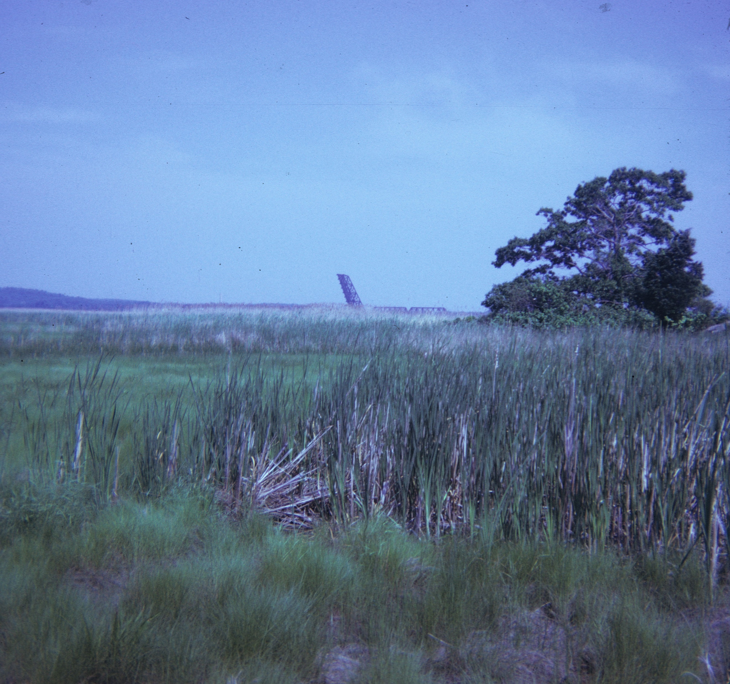
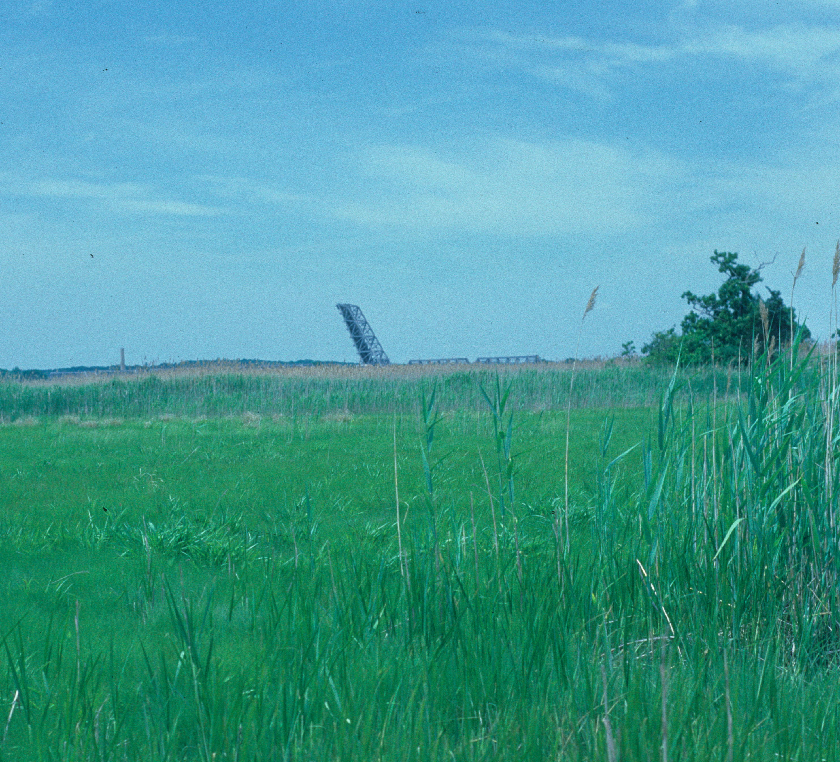
Invasion of Phragmites communis into a Typha angustifolia Community
Upper Island marsh, Lyme, CT, 1974: all Typha adjacent to Spartina community.
Nearly the same location, 1987: all Phragmites adjacent to Spartina community

Slide 10
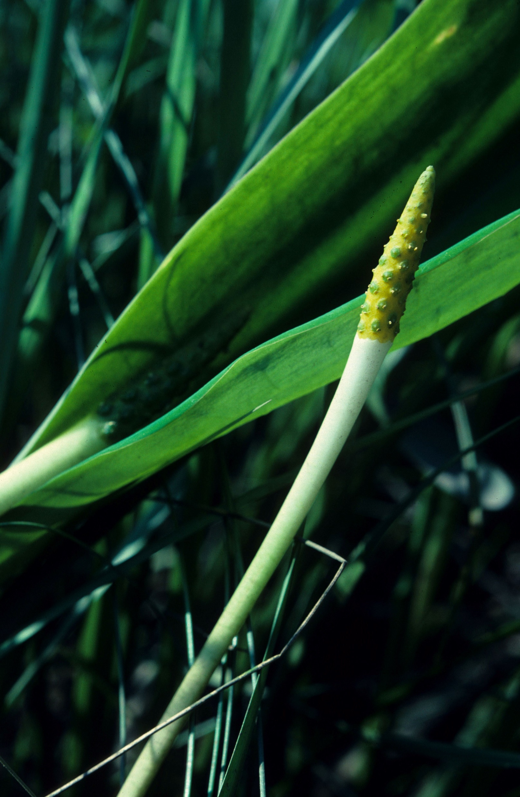
Freshwater Communities
Phragmites tends to form a monoculture, so all other plant species associated with the Typha community are eliminated as well.
Phragmites also invades freshwater marsh communities that tend to have much higher plant diversity than brackish and saltwater communities.
One of the species inhabiting some of the freshwater tidal marshes of the river is Orontium (right)- a mono-species genus endemic primarily to the eastern U.S. coastal plain.
The species occurs only locally in these marshes, so it is vulnerable to extirpation by community conversion to Phragmites.
Fortunately, freshwater tidal communities have proven more resistant to invasion, so the threat of extirpation is not imminent.

Slide 11
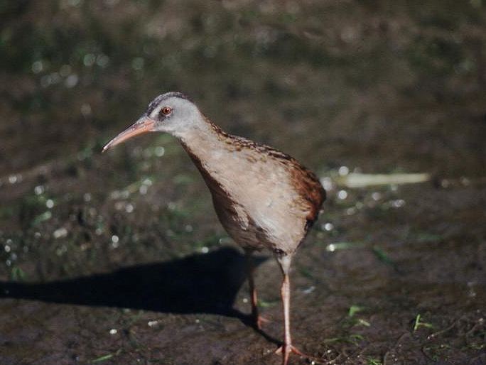
Effects on Wildlife
Conversion to Phragmites has affected wildlife communities of these marshes as well.
The Muskrat and other species feed on the roots of cattails, so densities drop in their absence.
Some bird species that use vegetation primarily for cover and nest sites appear less affected or positively affected by stand conversion.
Others species such as the Virginia Rail appear negatively affected, possibly because of change in the nature of the feeding habitat. Phragmites tends to raise the height of marsh vegetation, which makes substrates drier.
In general, it appears that only a subset of birds inhabiting marshes can also occupy reeds.
Moreover, Phragmites provides an avenue of invasion for bird species usually associated with shrubby marsh borders, thereby changing the nature of the marsh bird community.
As with plants, rare species are potentially most vulnerable to such habitat conversion.
Populations of the Virginia Rail appeared to decline with Phragmites invasion.

Slide 12
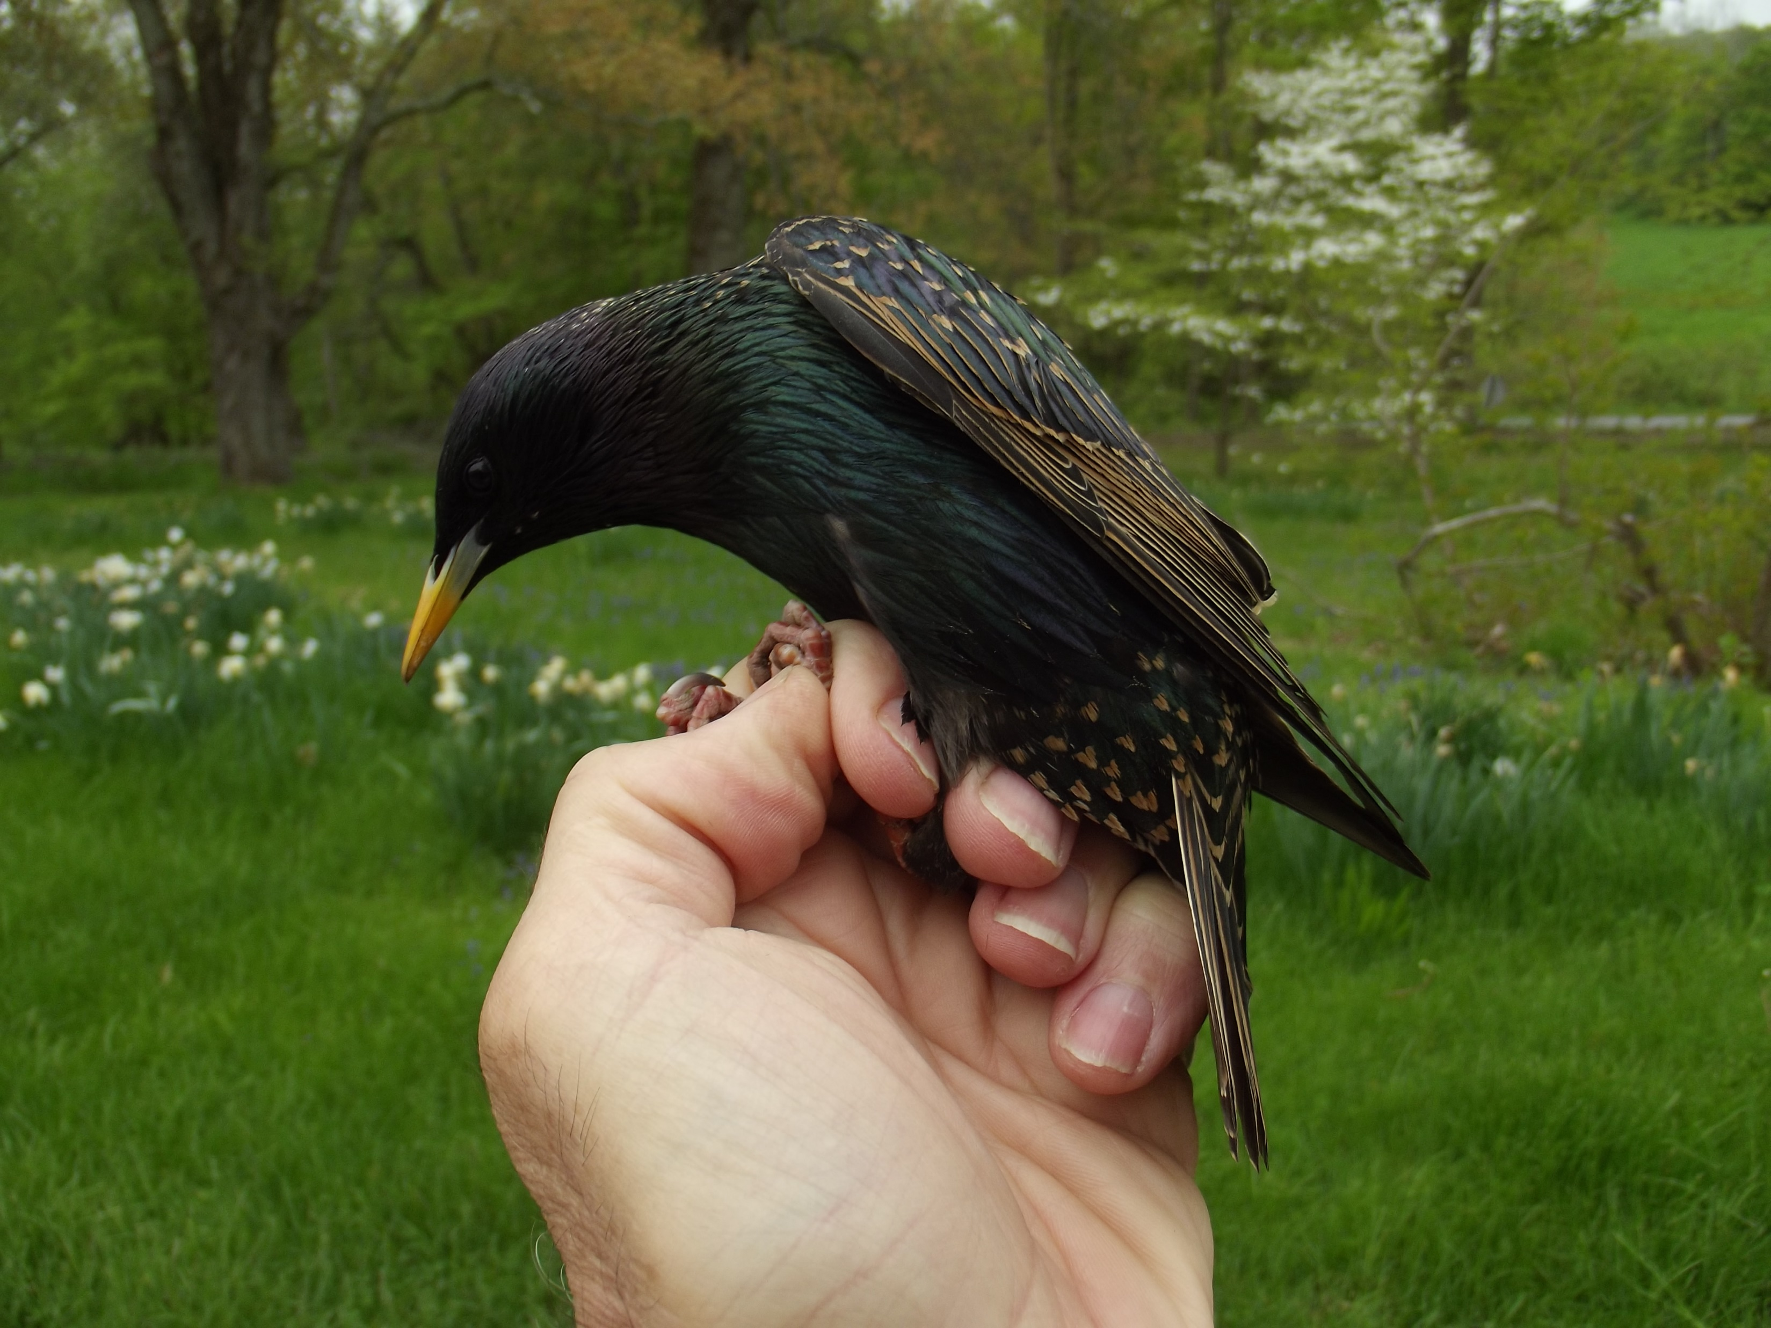
Introduced Competitors
Invasive species may act as competitors and eliminate other species from systems, as we have seen in the case of Phragmites.
Introduced species may also act as competitors, as does the European Starling.
This hole-nesting species is documented to compete with native hole-nesters, including the Eastern Bluebird and woodpecker species for nest sites.
However, in this case the European Starling is ecologically distinct enough from native species that it has not completely displaced any.
Continental species also appear to be effective competitors for species such as this one, with the aggressive Eastern Bluebird able to defend itself against competitors successfully.
More insidious is the effect of introduced species like the Japanese White-eye on island fauna.
The iridescent plumage and yellow bill of this European starling is indicative of spring plumage.
In this case, when they invade native forest, they out-compete native Hawaiian honeycreepers for food, which leaves their offspring underweight and more susceptible to disease.

Slide 13
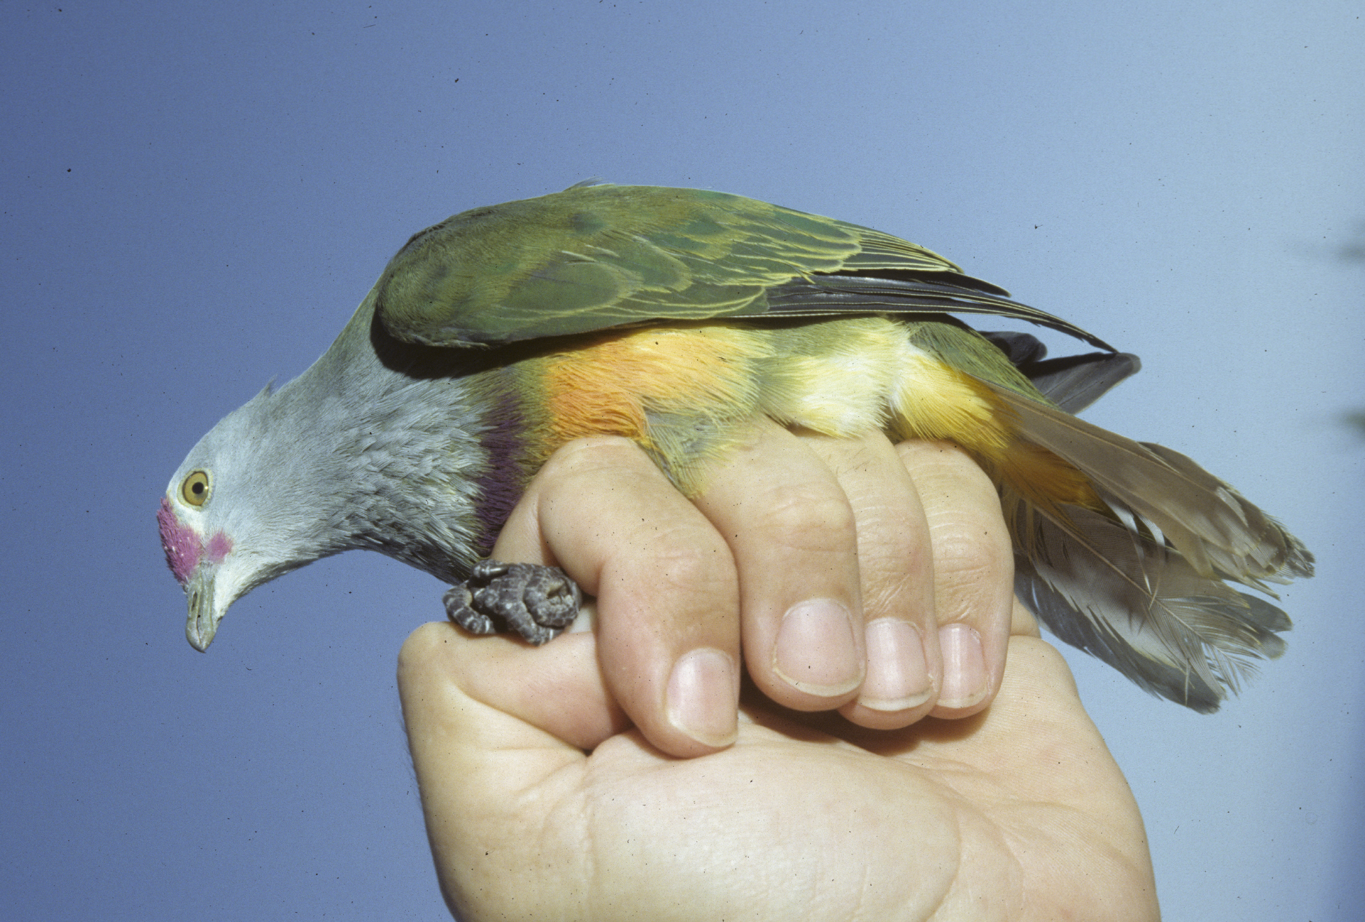
Introduced Predators
Invasive species may also be predators on native species. As is often the case, the most catastrophic cases involve island communities that have evolved in isolation from predators.
Case study: Brown Tree Snake
  The Brown Tree Snake, native to the Australia-Melanesia region, was transported to Guam via military shipments at the close of World War II.
  In the absence of natural controls, it underwent exponential population growth, preying upon native birds and reptiles and reaching densities of 100/ha.
  By the 1980s, or in about 40 years, the native birds, bats and reptiles of Guam had been almost completely eliminated.
  Since the disappearance of their seed dispersers, the native forest trees of Guam have also begun to decline.
  Hence, the introduction of a single predator has been responsible for the near complete collapse of the native ecosystem.
The Marianas Fruit Dove was one of the first native birds to disappear on Guam after the introduction of the Brown Tree Snake.

Slide 14
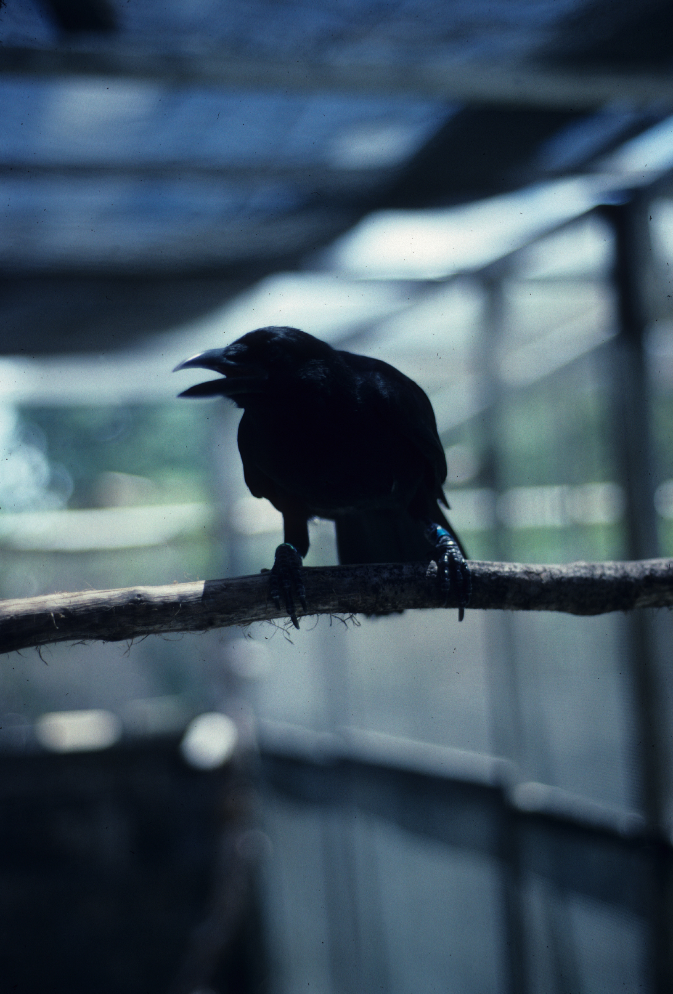
Control Efforts
Efforts at containing the damage wrought by the Brown Tree Snake have involved institution of captive breeding programs for species that could be removed from the wild quickly enough.
At present, captive breeding is underway for the Guam Rail, Guam Kingfisher and Marianas Crow.
Efforts at controlling the Brown Tree Snake have involved researching the possibility of introducing a snake-specific disease, finding predators of the snake in its native range and introduction of snake-specific toxins.
The latter approach has shown the most promise. Experiments with acetaminophen placed in mouse carcasses has resulted in 100% snake mortality.
However, the sheer number of snakes on Guam makes the implementation of such an effort daunting.
Marianas Crows have been brought into a captive breeding facility.

Slide 15
Plant predators
Case study: Serianthes nelsonii (right)
  The species has been uncommon since its discovery in the late 1800s.
  As of 1994, 121 mature trees existed in 16 subpopulations on the island of Rota and one was on Guam. Presently, 33 remain.
  Some seedlings and saplings also occur, primarily on Rota, although reproduction is at present negligible.
  All occur only in native forest that grows on limestone-derived soil, although historically populations also occupied soil of volcanic origin.
  Flowering and fruiting occurs mostly during the wet season in May-June, with seed dispersal poor, perhaps because of missing dispersal agents.
  A principal cause of poor regeneration appears to be browsing by introduced Philippine Deer and feral pigs.
  Like the rest of the flora, it evolved in isolation from ungulates, so has evolved no defenses against them.

Slide 16
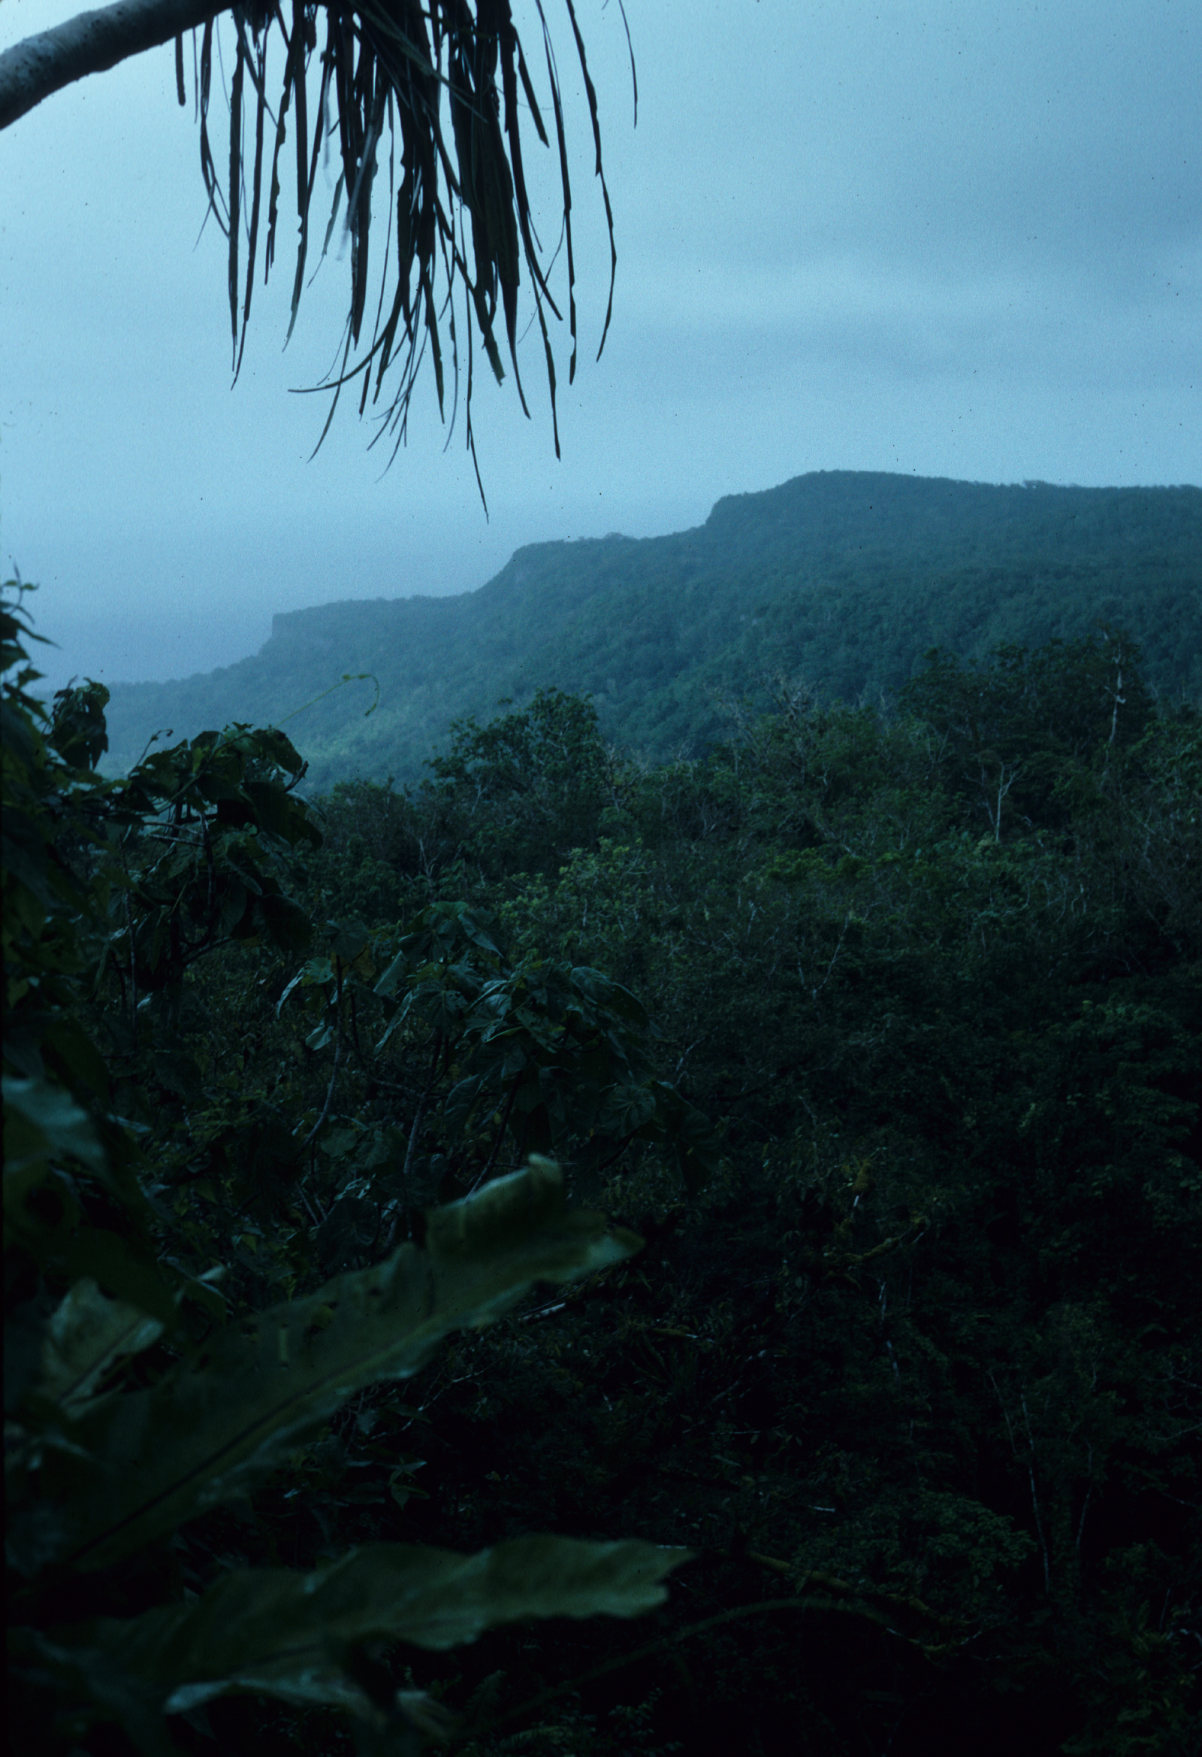
Serianthes nelsonii
  A second cause is predation on foliage and roots by insects, including a number of introduced species.
  Infestations cause significant seedling losses in cultivated populations.
  A fungal pathogen also appears to be suppressing survival of seedlings on Guam.
  Wildfire, common in the savannah vegetation of volcanic soils, appear responsible for eliminating populations in these regions.
  Hence, both density-dependent and density-independent factors contribute to the species rarity. The high elevation limestone forests of Rota (right) are the principal remaining refuge of the species.
  To date, treatment with pesticides had afforded only limited protection for seedlings.
  Propagation efforts are underway and techniques to improve germination are being tested.
  To date, wetting seeds for several months followed by drying them has yielded the highest percent germination.
  Seedling planting with fencing to eliminate browsing and netting to eliminate insect pests is showing some success.

